Slide 1


BIG DATA SECURITY
Đỗ Đặng Minh - 1311015
Huỳnh Công Toàn - 1311026
Supervisor: Associate Professor Dr. Tran Khanh Dang
Notes:
Version: 1.1
Last update: September 21, 2014

Slide 2
Outline
Big data
Characteristics of Big data
Challenges of Big data
Top Ten Security and Privacy Challenges
Reference

Slide 3
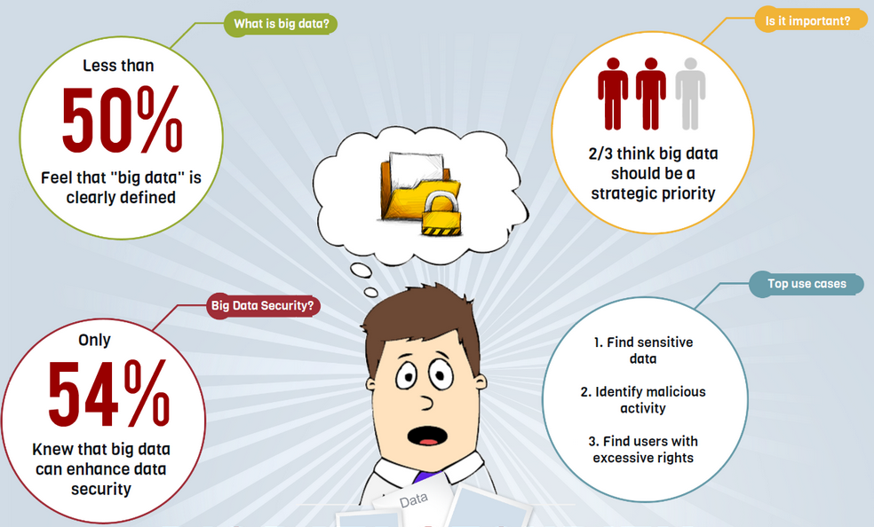
Big data
Big data is the capability to manage a huge volume of disparate data, at the right speed, and within the right time frame to allow real-time analysis and reaction.
https://varonis-assets.s3.amazonaws.com/assets/infographics/big-data-security.png
Notes:
Big data requires exceptional technologies to efficiently process large quantities of data within tolerable elapsed times. A 2011 McKinsey report suggests suitable
technologies include A/B testing, crowdsourcing, data fusion and integration, genetic algorithms, machine learning, natural language processing, signal
processing, simulation, time series analysis, and visualization.
Additional technologies being applied to big data include massively parallelprocessing (MPP) databases, search-based applications, data-mining grids, distributed file systems, distributed databases, cloud-based infrastructure (applications, storage, and computing resources), and the Internet.

Slide 4
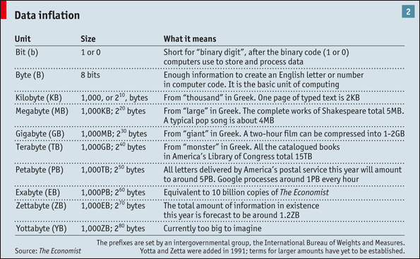
Big data
Notes:
Big Data analytics - the process of analyzing and mining Big Data - can produce operational and business knowledge at an unprecedented scale and specificity. The need to analyze and leverage trend data collected by businesses is one of the main drivers for Big Data analysis tools.

Slide 5
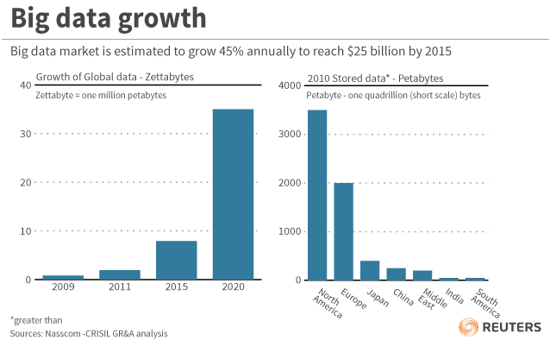
Big data
http://blog.thomsonreuters.com/wp-content/uploads/2012/10/big-data-growth.gif
Notes:
1 Terabyte = 1.000 Gigabyte
1 Petabyte = 1.000 Terabyte
1 Exabyte = 1.000 Petabyte
1 Zettabyte = 1.000 Exabyte = 1.000.000 Petabyte = 1.000.000.000 Terabyte

Slide 6
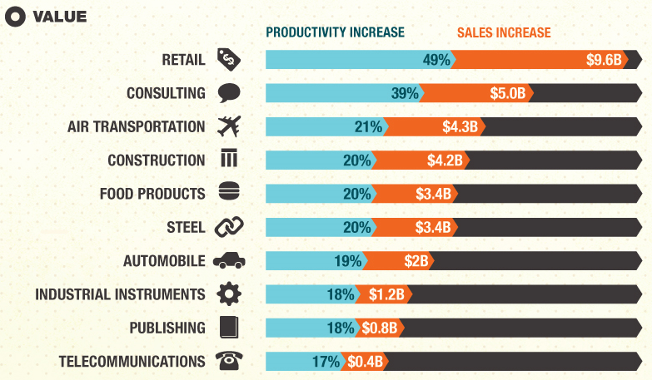
Big data
http://consumer.media.seagate.com/files/2013/02/Big-Data.jpg
Notes:
Advantages:
Big data integrates both structured and unstructured data.
Addresses speed and scalability, mobility and security, flexibility and stability.
In big data the realization time to information is critical to extract value from various data sources, including mobile devices, radio frequency identification, the web and a growing list of automated sensory technologies.

Slide 7
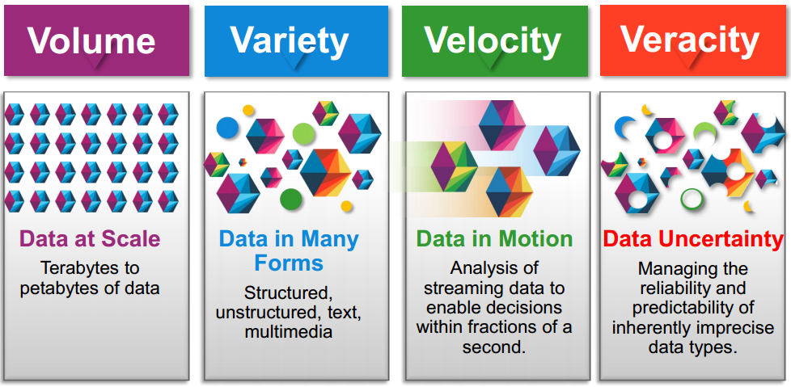

Characteristics of Big data
Notes:
IBM says that ”three characteristics define big data:”
Volume (Terabytes -> Zettabytes)
Variety (Structured -> Semi-structured -> Unstructured)
Velocity (Batch -> Streaming Data)
The meaning of “real time” can vary depending on the context in which it is used.

Slide 8
Characteristics of Big data
Volume: The volume of data here is very huge and is generated from a lot of different devices.
Variety: Big data consists of a variety of different types of data i.e. structured, unstructured and semi structured data.
Velocity: This describes the real time attribute found in some of the data sets for example streaming data.
Veracity: This deals with uncertain or imprecise data.
Value: This refers to the complex, advanced, predictive, business analysis and insights associated with the large data sets.
Volatility: Big Data volatility refers to how long the data is going to be valid and how long it should be stored
Complexity: A complex dynamic relationship often exists in Big data.
Notes:
Variety:
People to people: Netizens, virtual communities, social networks, web logs,…
People to machine: archives, medical devices, digital TV, e-commerce, smart cards, bank cards, computers, mobiles,…
Machine to machine: sensors, GPS devices, bar code scanners, surveillance cameras, scientific research,…
Structured data: This type describes data which is grouped into a relational scheme.
Semi-structured data: This is a form of structured data that does not conform to an explicit and fixed schema.
Unstructured data: This type of data consists of formats which cannot easily be indexed into relational tables for analysis or querying.
Velocity:
2.9 million emails sent every second
20 hours of video uploaded every min
50 million tweets per day

Slide 9
Characteristics of Big data
Big data
Big data science
Big data framework
Big data infrastructure
Notes:
Big data science is the study of techniques covering the acquisition, conditioning, and evaluation of big data. These techniques are a synthesis of both information technology and mathematical approaches.
Big data frameworks are software libraries along with their associated algorithms that enable distributed processing and analysis of big data problems across clusters of compute units (e.g., servers, CPUs, or GPUs). Big Data Frameworks are often associated with the term NoSQL.
Big data infrastructure is an instantiation of one or more big data frameworks that includes management interfaces, actual servers (physical or virtual), storage facilities, networking, and possibly back-up systems. Big data infrastructure can be instantiated to solve specific big data problems or to serve as a general purpose analysis and processing engine.

Slide 10

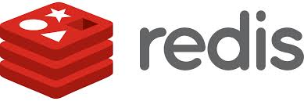


Characteristics of Big data
Data administration:
Storage: Amazon S3, Hadoop Distributed File System.
NoSQL: Apache Hadoop, Apache Casandra, MongoDB, Apache CouchDB, Redis, BigTable.
Notes:
Hadoop, which is a free, Java-based programming framework supports the processing of large sets of data in a distributed computing environment. It is a part of the Apache project sponsored by the Apache Software Foundation. Hadoop cluster uses a Master/Slave structure.
Example: In traditional systems, searching among a month’s load of data could take between 20 minutes and an hour. In new Hadoop system running queries with Hive, they get the same results in about one minute.
Image reference:
http://robertianhawdon.me.uk/blog/wp-content/uploads/2014/02/redis-300dpi.png
https://surfsara.nl/sites/default/files/Hadoop_logo.jpg
http://upload.wikimedia.org/wikipedia/commons/thumb/1/1d/AmazonWebservices_Logo.svg/1280px-AmazonWebservices_Logo.svg.png
http://ddf912383141a8d7bbe4-e053e711fc85de3290f121ef0f0e3a1f.r87.cf1.rackcdn.com/mongoDB-logo.png

Slide 11
Characteristics of Big data
NoSQL Origins
First used in 1998 to mean “No to SQL”
Reused in 2009 when it came to mean “Not Only SQL”
Groups non-relational approaches under a single term
When to use NoSQL?
Ability to handle semi-structured and unstructured data
Horizontal scalability
When not to use NoSQL?
Specialized solutions may be faster or more scalable.
NoSQL generally has less querying power than SQL.
NoSQL may complement RDBMS (but sometimes replaces)
RDBMS may hold smaller amounts of high-value structured data.
NoSQL may hold vast amounts of less valued and less structured data.

Slide 12
Challenges of Big data
Privacy, security & trust
Government agencies when collecting or managing citizens data.
Big data sources, the transport and delivery systems within and across agencies, and the end points for this data will all become targets of interest for hackers.
The public trust in government agencies and systems needs to be maintained.
Notes:
Commercial Institutions Collecting Data Have Insufficient Data Security to Protect Americans’ Privacy.
Students are Particularly Vulnerable to Big Data Privacy Risks.
Government Collection of Big Data is Particularly Problematic.

Slide 13
Challenges of Big data
Data management and sharing
Data also needs to be accurate, complete and timely if it is to be used to support complex analysis and decision making.
The current trend towards open data and open government has seen a focus on making data sets available to the public.
Concerns over the ability for personally identifiable information to be extracted.
Notes:
Data leakage can be costly. In March 2012, hackers broke into Utah’s Department of Health database and downloaded personal data from 780,000 patients (Social Security Numbers were downloaded for 280,000 patients); Utah’s Governor responded by firing the Department’s CTO; and the State of Utah was forced to pay-out ~$9 million on security audits, security upgrades, and identity theft protection measures for patients (Stewart and The Salt Lake Tribune, 2013)

Slide 14
Challenges of Big data
Technology and analytical systems
Big data and the cloud
Skills
Science
Technological
Research
Statistical, analytical & interpretive skills
Creativity
Business process
Notes:
Vulnerable to Trojan Horse Attact:
Hidden functionality in big data apps & “solutions
Big data application user is unwitting agent
Big data cloud paradigm opens vast opportunity
Trap Door Platform Subversion:
Malicious code in platform running big data apps
Can be remotely activated/deactivated
Efficacy and Effectiveness Demonstrated

Slide 15

Top Ten Security and Privacy Challenges
Big Data Working Group
Infrastructure Security
Secure Computations in Distributed Programming Frameworks
Security Best Practices for Non-Relational Data Stores
Data Privacy
Privacy Preserving Data Mining and Analytics
Cryptographically Enforced Data Centric Security
Granular Access Control
Data Management
Secure Data Storage and Transaction Logs
Granular Audits
Data Provenance
Integrity and Reactive Security
End-point validation and filtering
Real time Security Monitoring
Notes:
Solving security and privacy challenges typically requires addressing three distinct issues:
1. Modeling: formalizing a threat model that covers most of the cyber-attack or data-leakage scenarios
2. Analysis: finding tractable solutions based on the threat model
3. Implementation: implementing the solution in existing infrastructures

Slide 16
Secure Computations in Distributed Programming Frameworks
Use Case: MapReduce framework.
Threat model:
Malfunctioning Compute Worker Nodes
Infrastructure Attacks
Rogue Data Nodes
Solutions:
Trust establishment: initial trust establishment followed by periodic trust update.
Mandatory Access Control
Implementation:
Performance penalties due to imposing MAC.
Limitations of differential privacy in providing guarantees.

Slide 17
Security Best Practices for Non-Relational Data Stores
Use Case: NoSQL databases.
Threat model:
Transactional Integrity
Lax Authentication Mechanisms
Inefficient Authorization Mechanisms
Susceptibility to Injection Attacks
Lack of Consistency
Insider Attacks
Solutions:
Encrypted password, data
Trusted communication channel
Data tagging techniques
Implementation:
Hadoop supports strong Kerberos authentication.

Slide 18
Secure Data Storage and Transactions Logs
Use Case: auto-tier storage system.
Threat model:
Confidentiality and Integrity
Provenance
Availability
Consistency
Collusion Attacks
Roll-Back Attacks
Disputes
Solutions:
Robust encryption techniques and message-digests
Periodic audit and chain hash
Implementation:
Dynamic Data Operations
Privacy Preservation (third-party auditor)
Secure Manipulations on Encrypted Data

Slide 19
End-Point Input Validation/Filtering
Use Case: end-point devices.
Threat model:
Data tampering
Sybil attacks (ID cloning attacks)
Manipulating the input sources of sensed data
Compromising data in transmission
Solutions:
Tamper-proof software and defenses against Sybil attacks
Peer-to-peer systems, recommender systems
Implementation:
No foolproof approach for input validation and filtering
Hybrid approach
Notes:
Data tampering: compromise the iPhone app that collects user feedback.
Sybil attacks (ID cloning attacks): fake the identity of a trusted device and then provide malicious input to the central data collection system.
Manipulating the input sources of sensed data: compromise the GPS signal itself by using GPS satellite simulators.
Compromising data in transmission: man-in-the-middle attack or a replay attack.

Slide 20
Real-Time Security Monitoring
Use Case: healthcare data.
Threat model:
Rogue admin access to applications or nodes
Eavesdropping on the line
Evasion attacks
Data poisoning attacks
Solutions:
Big data analytics
Implementation:
Storm (storm-project.net)
Apache Kafka

Slide 21
Scalable and Composable Privacy-Preserving Data Mining and Analytics
Use Case: user data accessed by inside analysts & outside contractors.
Threat model:
Insider
Untrusted partner
Sharing data for research
Solutions:
Continuous monitoring
Differential privacy
Homomorphic encryption
Implementation:
Keep software infrastructure patched with up-to-date security solutions.
Separation of duty principle
Be aware of re-identification techniques.

Slide 22
Cryptographically Enforced Data-Centric Security
Use Case: encrypted data
Threat model:
Identify the corresponding plaintext data by looking at the ciphertext.
Learn something about the encrypted data.
Forge data that did not come from the purported source.
Solutions:
Identity and attribute based encryption methods
Public key system
Homomorphic encryption scheme
Group signatures
Implementation:
Elliptic curve groups that support bilinear pairing maps.

Slide 23
Granular Access Control
Use Case: granular access controls.
Threat model: inconsistent incorporation into the application layer
Keeping track of secrecy requirements for individual data elements.
Keeping track of roles and authorities for users.
Properly implementing secrecy requirements with mandatory access control.
Solutions:
Cell-level access control
Label storage, query-time access checks
Implementation:
Apache Accumulo
Notes:
Granular access control: the ability to enforce granular access controls gives the administrator the power to provide employees, partners, and clients with remote access to very specific and defined resources, according to the needs of each remote user.
In Accumulo, every atomic key/value pair is tagged with an expression that describes the roles required to read that entry, and every query includes a role check.

Slide 24
Granular Audits
Use Case: granular audits (financial firms).
Threat model:
Completeness of the required audit information.
Timely access to audit information.
Integrity of the information.
Authorized access to the audit information.
Solutions:
Auditing capabilities need to be enabled across the Big Data infrastructure.
Implementation:
Enabling syslog on routers, application logging, and enabling logging on the operating system level.
Have the forensics/SIEM tool implemented and used outside of the Big Data infrastructure when feasible.
Notes:
PCI Compliance
Sarbanes-Oxley Act, Sarbox or SOX (2002) is a United States federal law that set new or enhanced standards for all U.S. public company boards, management and public accounting firms. SOX increased the oversight role of boards of directors and the independence of the outside auditors who review the accuracy of corporate financial statements.

Slide 25
Data Provenance
Use Case: time-sensitive provenance metadata.
Threat model:
Malfunctioning Infrastructure Components
Infrastructure Outside Attacks
Infrastructure Inside Attacks
Solutions:
Periodic status updates
Integrity & consistency checks
Encryption techniques
Fine-grained access control of provenance
Implementation:
Secure channels
Fine-grained access control

Slide 26
Reference
Big Data Working Group: “Big Data Analytics for Security Intelligence”, Cloud Security Alliance, 2013.
Big Data Working Group: “Expanded Top Ten Big Data Security and Privacy Challenges”, Cloud Security Alliance, 2013.
Hurwitz, Alan Nugent, Fern Halper and Marcia Kaufman: “Big Data For Dummies”, John Wiley & Sons, Inc., ISBN 978-1-118-64401-0, 2013.
James Manyika, Michael Chui, Brad Brown, Jacques Bughin, Richard Dobbs, Charles Roxburgh, Angela Hung Byers: “Big data: The next frontier for innovation, competition, and productivity”, McKinsey Global Institute, 2011.
Joseph McKendrick: “Big Data, Big Challenges, Big Opportunities”, Unisphere Research, Division of Information Today, Inc., 2012.
Kudakwashe Zvarevashe, Mainford Mutandavari, Trust Gotora: “A Survey of the Security Use Cases in Big Data”, IJIRCCE, 2014.
Marco Albertoni: “Big Data and Analytics”, IBM Corporation, 2014.
Michael Cooper, Peter Mell: “Tackling Big Data”, NIST Information Technology Laboratory, 2012.
Steve Piper: “Big Data Security for Dummies”, John Wiley & Sons, Inc., ISBN 978-1-118-51727-7, 2013.
Tina Chen: “Security and Audit for Big Data”, IBM Corporation, 2013.
“Big Data Strategy - Issues Paper”, © Commonwealth of Australia, 2013.

Slide 27
Thank You !

